Slide 1
Capstone Project
Ajay Pradeep M
Mobile Price Range Prediction

Slide 2
Data Summary
Dataset | data_mobile_price_range.csv
Data Description | In the competitive mobile phone market companies want to understand sales data of mobile phones and factors which drive the prices.
Problem Description | The objective is to find out some relation between features of a mobile phone(eg:- RAM,Internal Memory, etc) and its selling price. In this problem, we do not have to predict the actual price but a price range indicating how high the price is.
Shape | 2000 rows and 21 columns

Slide 3
Data Fields:
Battery_power - Total energy a battery can store in one time measured in mAh
Blue - Has bluetooth or not
Clock_speed - speed at which microprocessor executes instructions
Dual_sim - Has dual sim support or not
Fc - Front Camera mega pixels
Four_g - Has 4G or not
Int_memory - Internal Memory in Gigabytes
M_dep - Mobile Depth in cm
Mobile_wt - Weight of mobile phone
N_cores - Number of cores of processor
Pc - Primary Camera mega pixels
Px_height - Pixel Resolution Height
Px_width - Pixel Resolution Width
Ram - Random Access Memory in Mega Bytes
Sc_h - Screen Height of mobile in cm
Sc_w - Screen Width of mobile in cm
Talk_time - longest time that a single battery charge will last when you are
Three_g - Has 3G or not
Touch_screen - Has touch screen or not
Wifi - Has wifi or not
Price_range - This is the target variable with value of 0(low cost), 1(medium cost), 2(high cost) and 3(very high cost).

Slide 4

Data Preprocessing
Checking for null values and removing them.
Converting data types.
Removing outliers.
Checking whether column renaming is required.
Creating new columns if required.
Feature Selection
Train-Test Split

Slide 5
Univariate Analysis

Slide 6
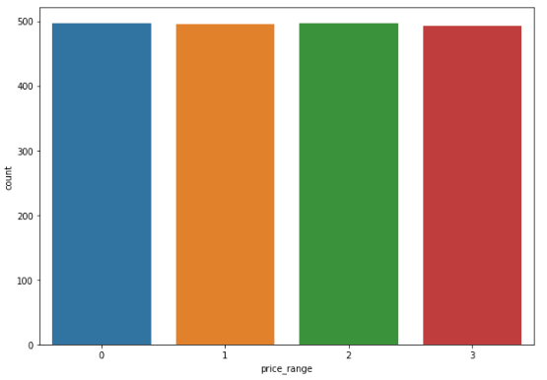
Dependent Variable - price_range

Slide 7
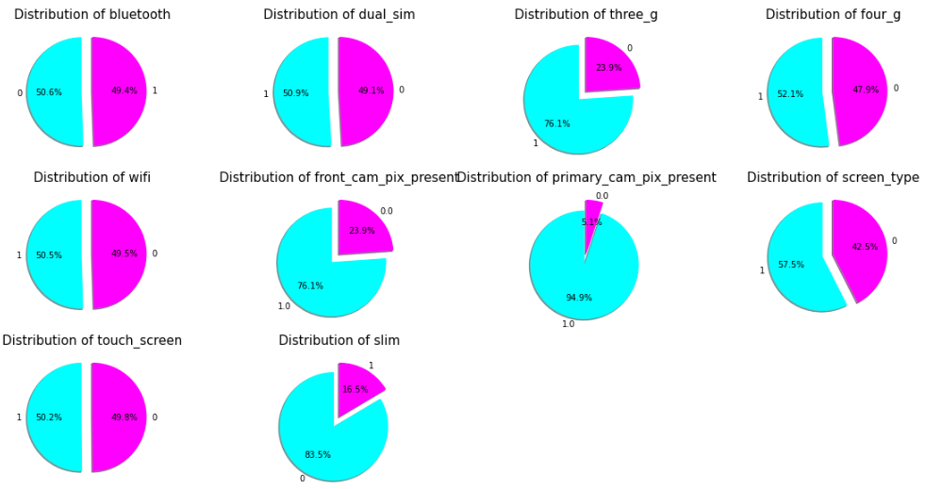
Features with binary values

Slide 8
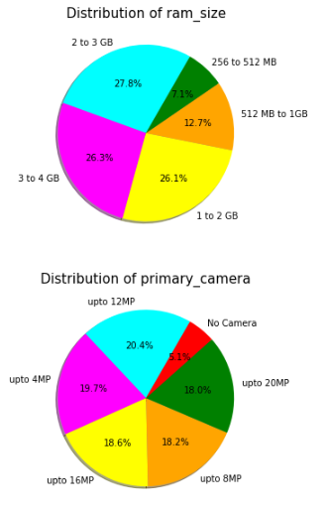
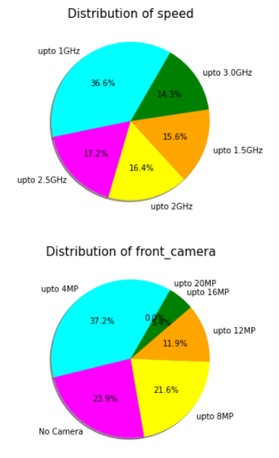
Categorical variables pie plot

Slide 9
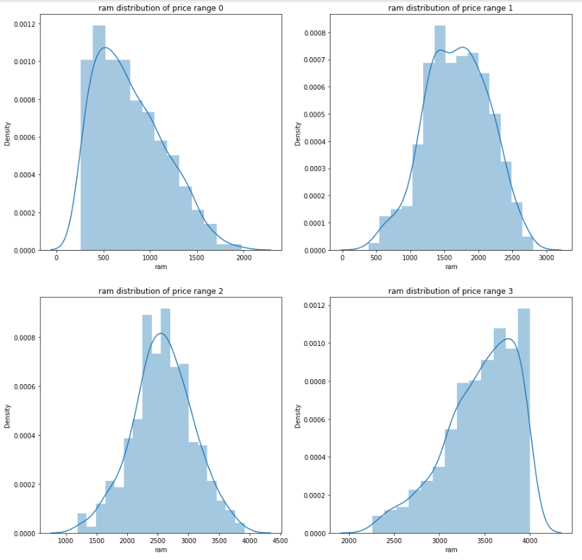
RAM Distribution based on price range

Slide 10
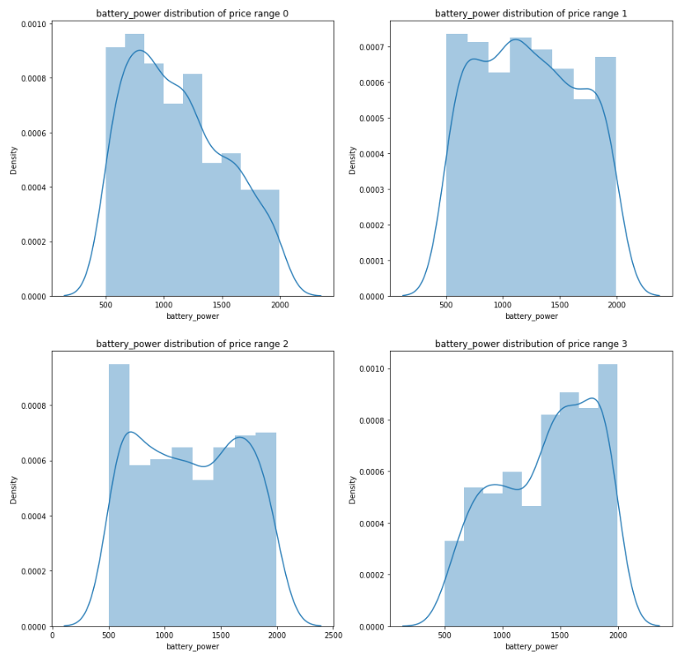
Battery Power Distribution based on price range

Slide 11
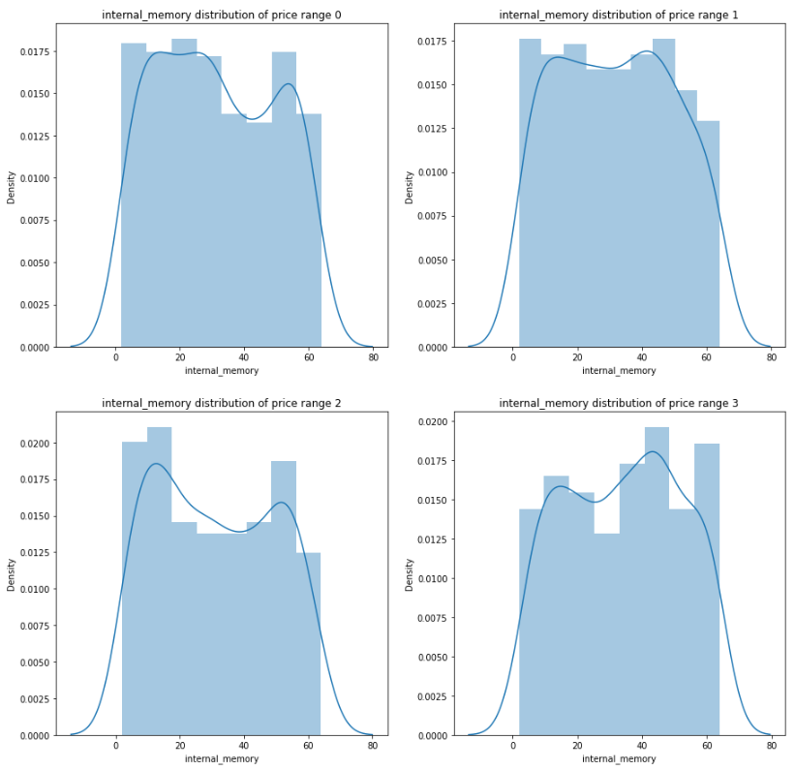
Internal Memory Distribution based on price range

Slide 12
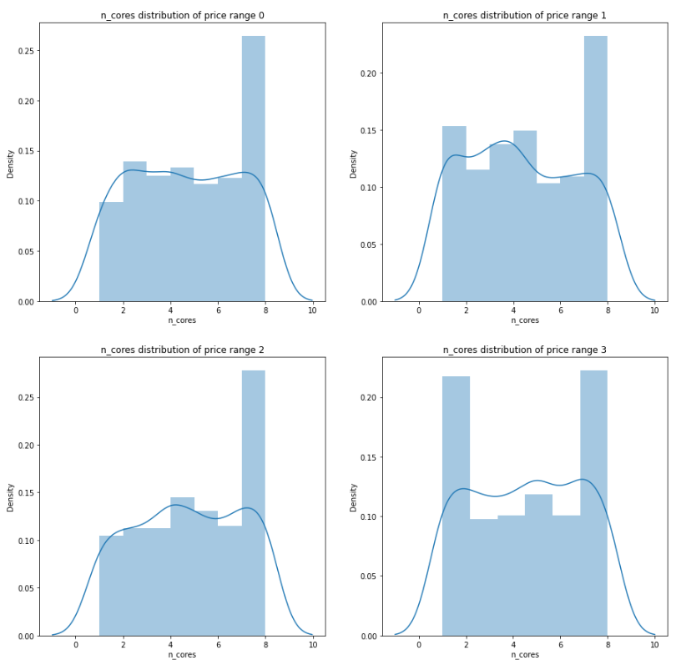
Number of Cores Distribution based on price range

Slide 13
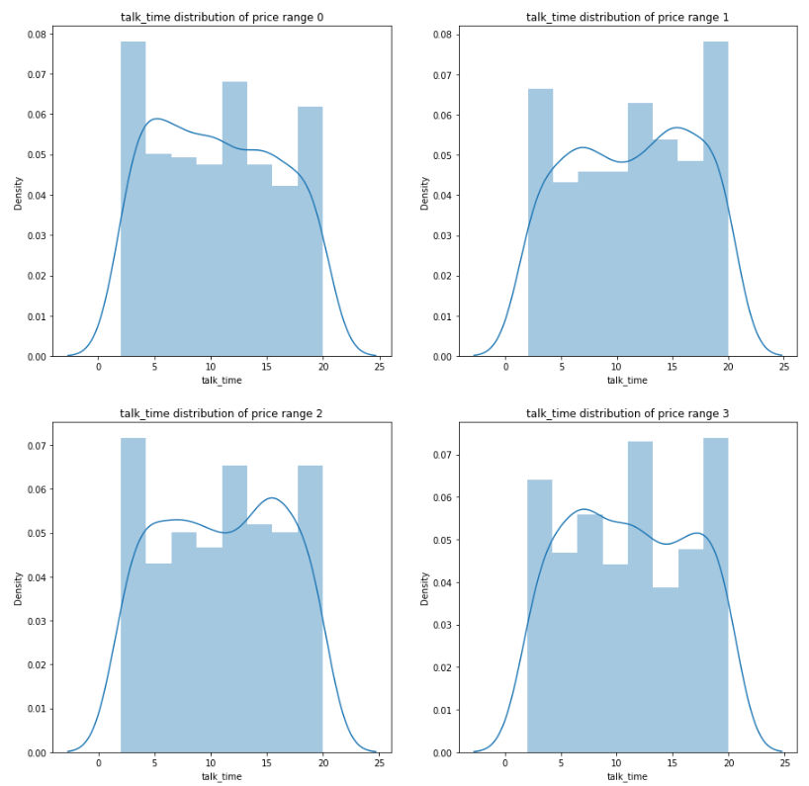
Talk Time Distribution based on price range

Slide 14
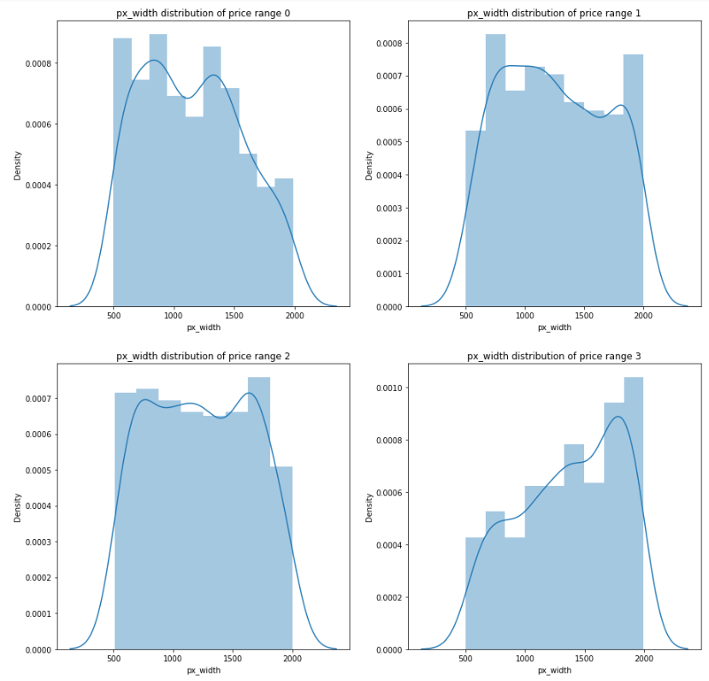
Pixel Width Distribution based on price range

Slide 15
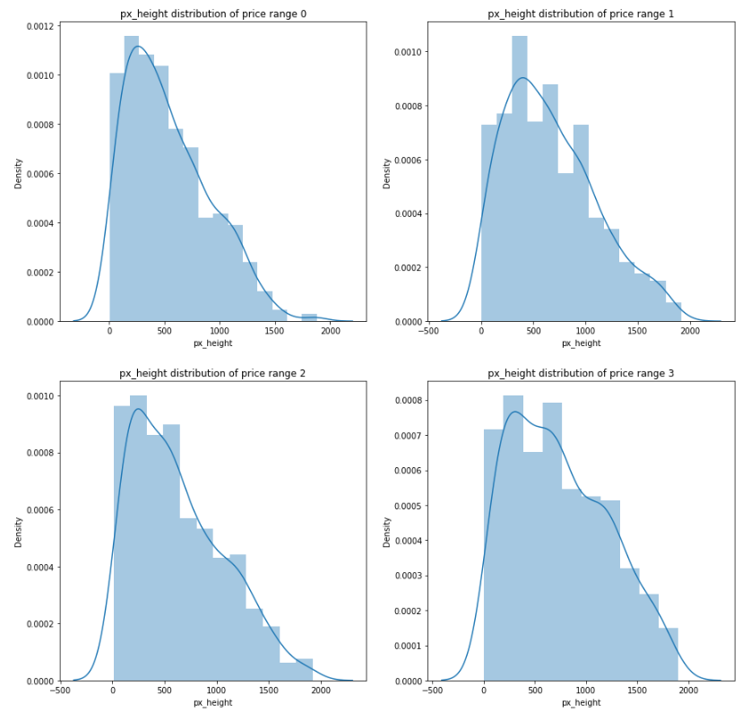
Pixel Height Distribution based on price range

Slide 16
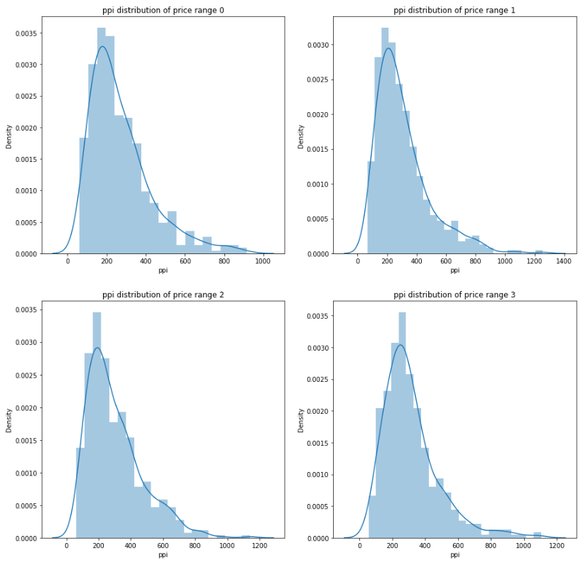
PPI Distribution based on price range

Slide 17
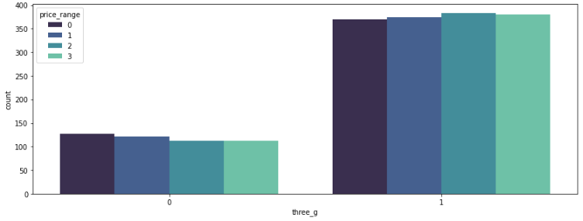
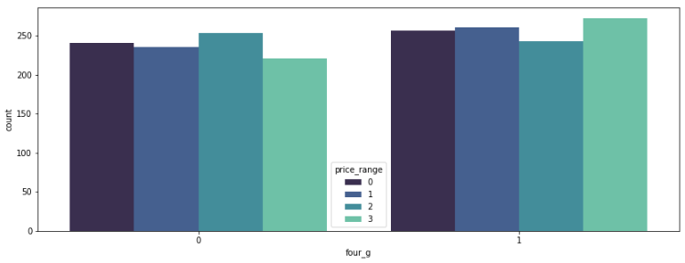
3G and 4G countplot

Slide 18
Multivariate Analysis

Slide 19
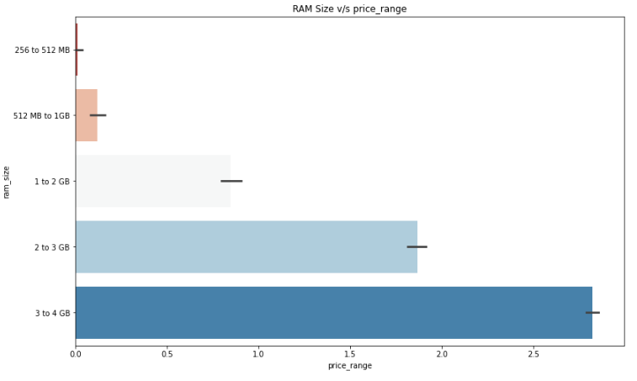
RAM Size v/s Price Range

Slide 20
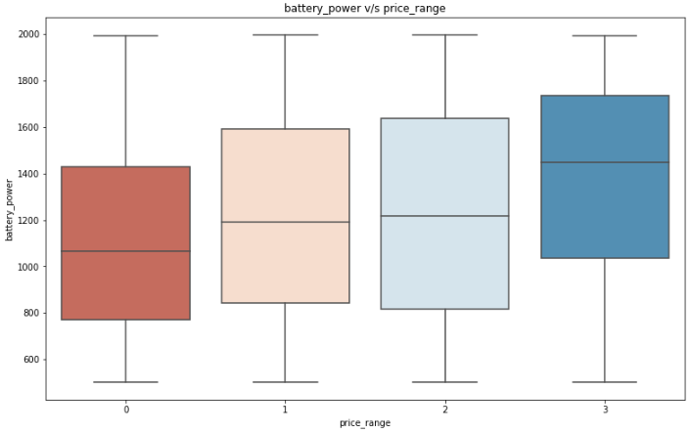
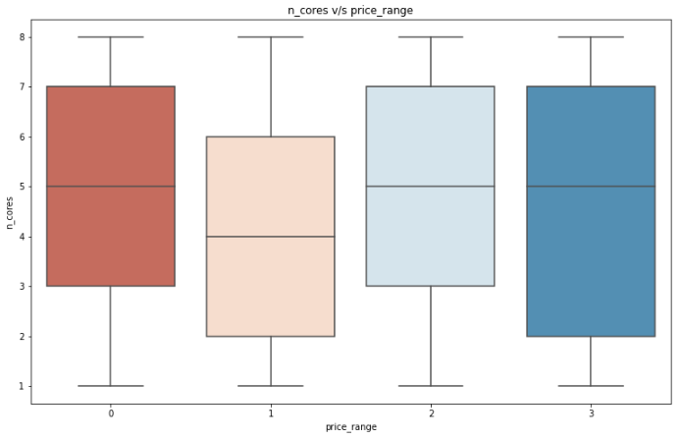
Battery Power v/s Price Range
Number of Cores v/s Price Range

Slide 21
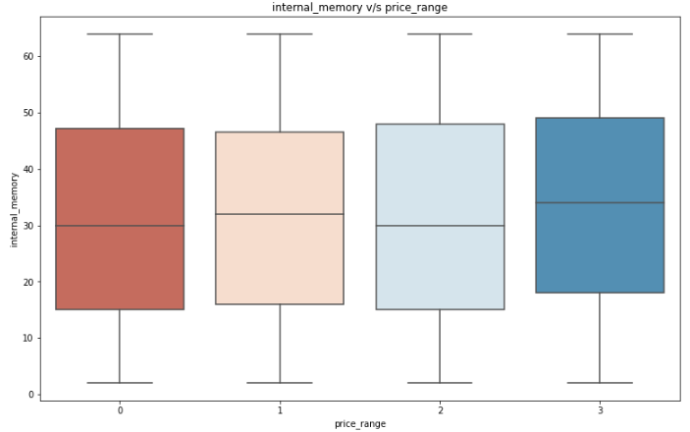
Internal Memory v/s Price Range

Slide 22
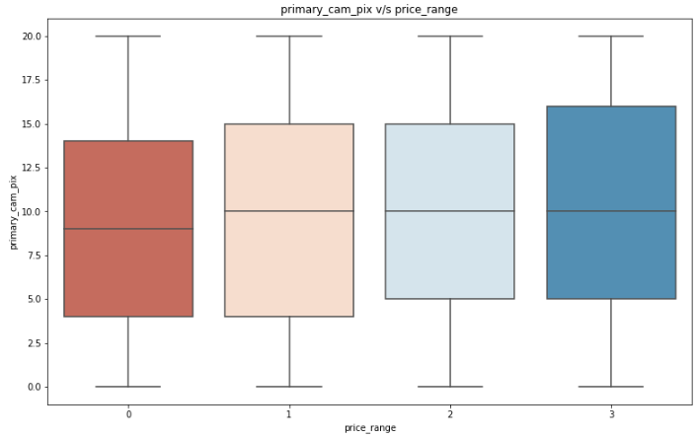
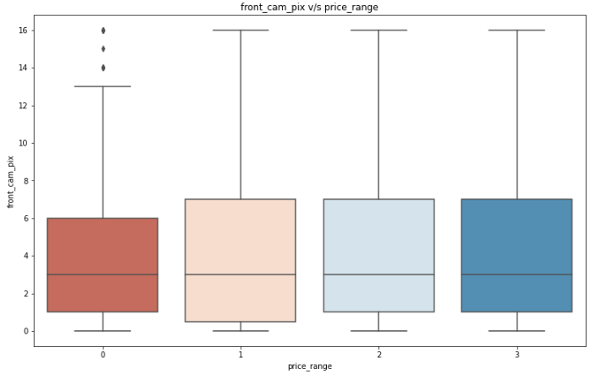
Cameras v/s Price Range

Slide 23
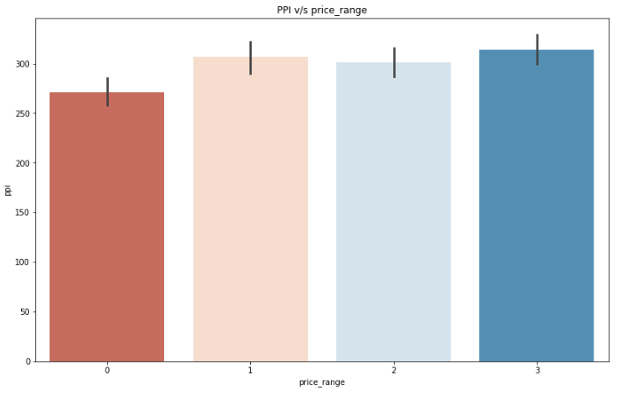
PPI v/s Price Range

Slide 24
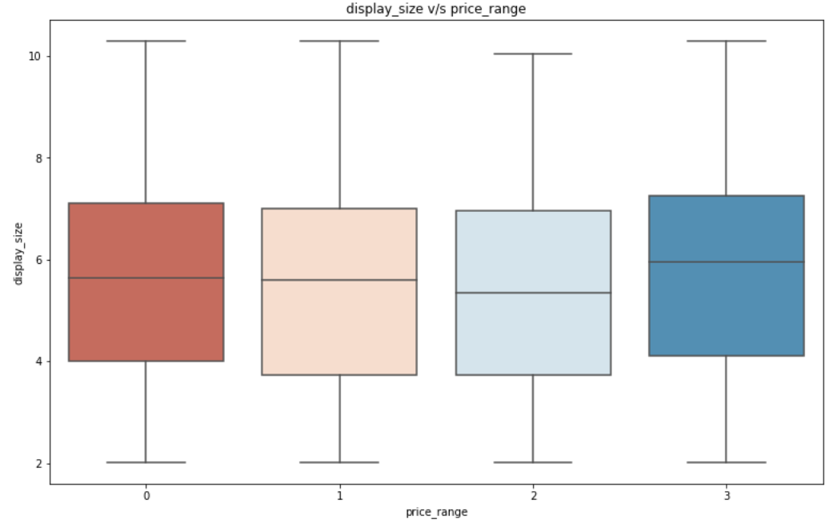
Display size v/s Price Range

Slide 25
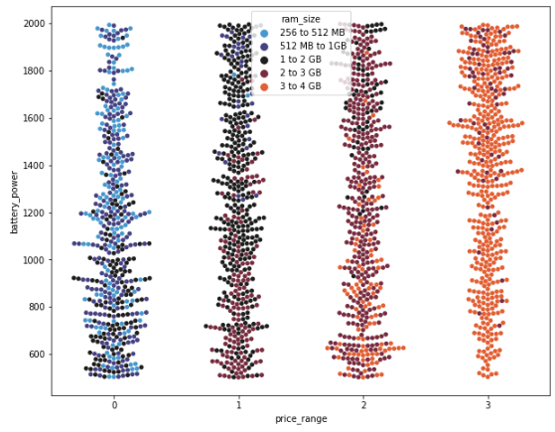
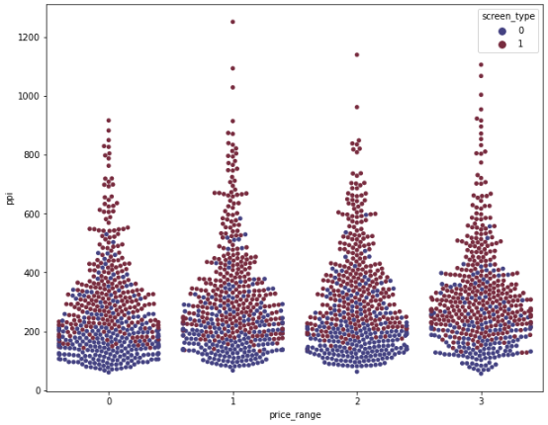
Price Range, Battery Power and RAM size
Price Range, PPI and Screen Type

Slide 26
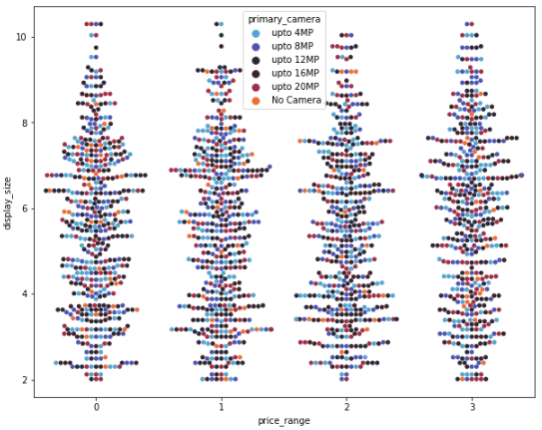
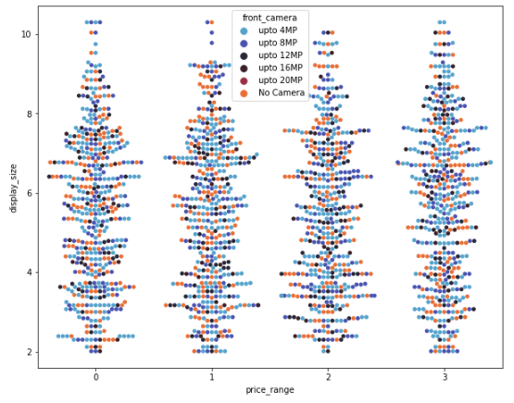
Price Range, Display Size, Primary and Front Camera

Slide 27
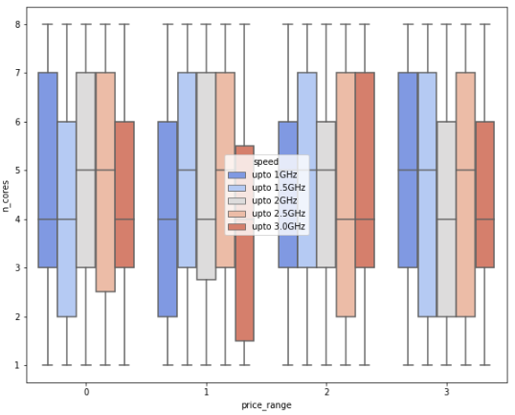
Price range, Number of Cores and Speed

Slide 28
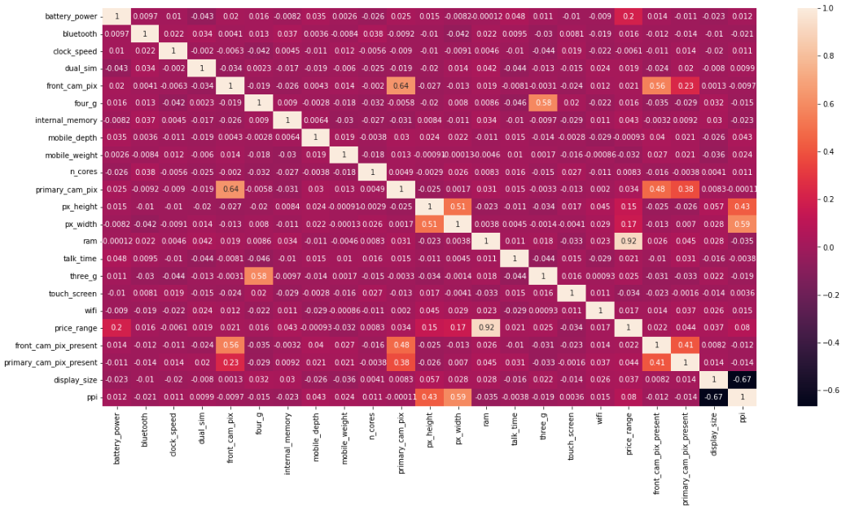
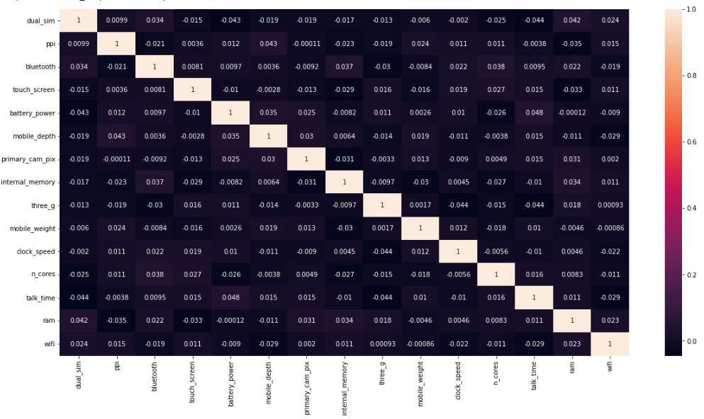
Correlation Analysis

Slide 29
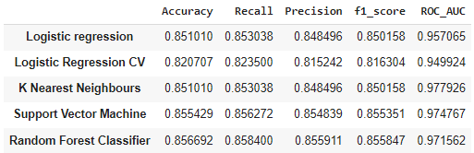
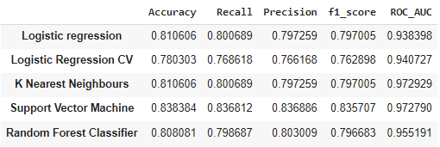
Model Implementation and Evaluation
Train Data
Test Data

Slide 30
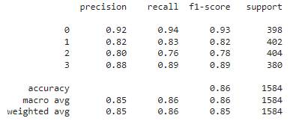
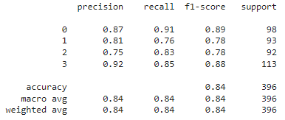
Classification Report of SVM
Train Data
Test Data

Slide 31
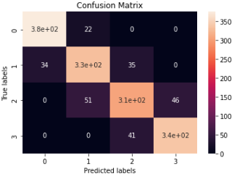
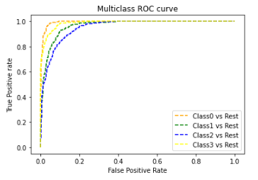
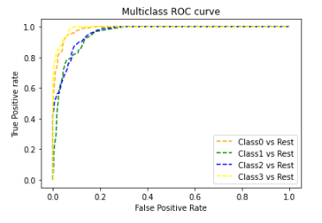
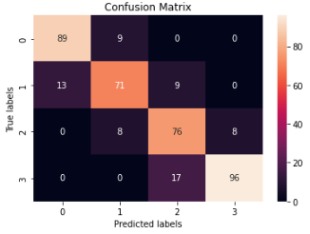
Confusion Matrix and ROC curve of SVM
Train Data
Test Data

Slide 32
Challenges
Small dataset.
Missing features.
Cross validation computation time.

Slide 33
CONCLUSION
The quality of the phone increases with each price range.
Some features that are high in lower price range, have other specs of lower version.
This is an old data, where 4G mobiles are in low numbers, which shows that this technology is relatively new for this particular dataset.
Also many mobiles do not have smartphone features.
Some missing features found such as RAM type, Processor name etc.

